Slide 1


Climate Change: Earth Surface Temperature Data
This presentation explores the analysis of a weather and global temperature dataset using SQL Server Management Studio (SSMS) and SQL Server Integration Services (SSIS).

Slide 2

Preparing the Data in SSMS
1
Data Import
Import the raw weather data into SQL Server using SSMS.
2
Database Design
Create tables and relationships to structure the data effectively.
3
Data Validation
Verify data integrity and consistency to ensure reliable analysis.

Slide 3
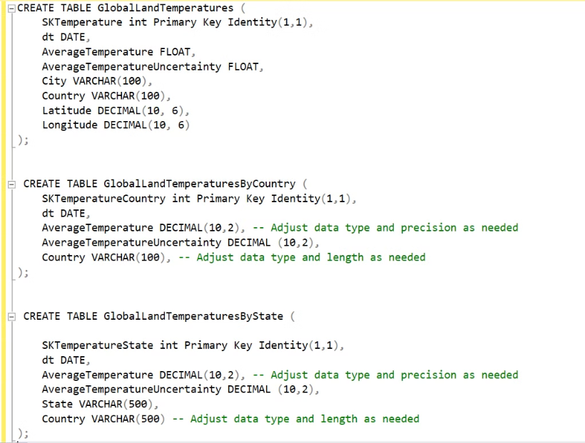
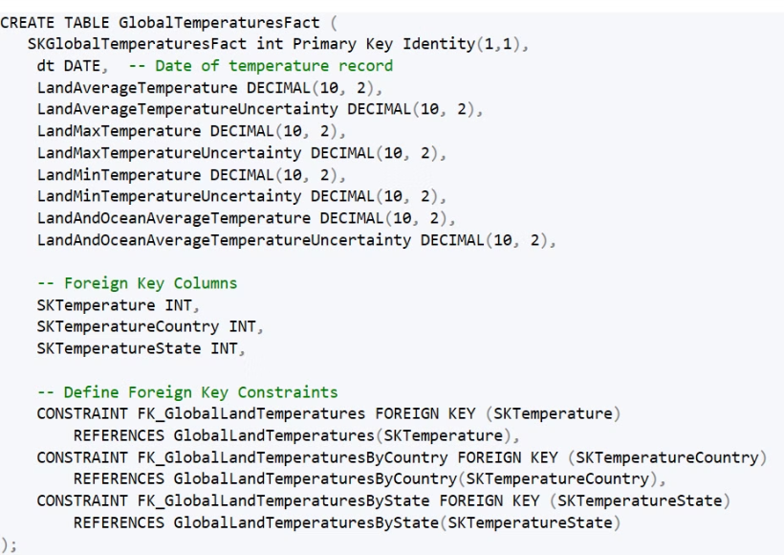
SCHEMA OF DATABASE
schema of our fact table
3 dimantions of fact table

Slide 4
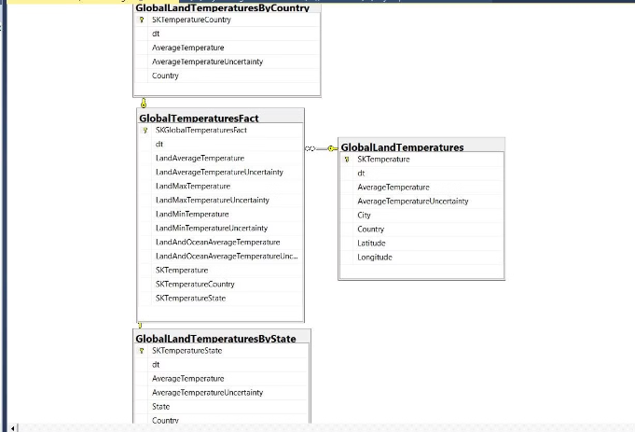
Star Schema
The star schema is an important data modeling technique used in data warehousing
Centralized Fact Table: The fact table holds the main metrics (temperature data) and references to related dimensions.
Dimension Tables: Each dimension provides context (country, state, and location information) that enriches the analysis.
Notes:
The star schema is an important data modeling technique used in data warehousing It consists of a central fact table that holds the key metrics, surrounded by dimension tables that provide context The fact table references the dimension tables, allowing for efficient queries and reporting Some key advantages of the star schema: Centralized fact table with linked dimensions Dimension tables provide rich contextual information Efficient querying and reporting through direct links Scalability to add new dimensions or facts without restructuring Star schemas are a widely adopted best practice in data warehousing, optimizing read performance and enabling OLAP analysis

Slide 5
SSIS
1
Data cleaning
2
Data transformation
In the data cleansing phase, duplicates are removed, missing values are handled, and errors are corrected.
In the data transformation involves converting data types, aggregating data, and creating derived columns to ensure that the data is in a suitable format for analysis.
3
These steps are essential for maintaining data quality and consistency throughout the analytical process.

Slide 6

In SSIS, when inserting data into a table multiple times, issues such as duplicate records or primary key violations can occur. A common way to prevent this is by truncating the table before each data load. This ensures that the table is empty and ready for new data.

Slide 7
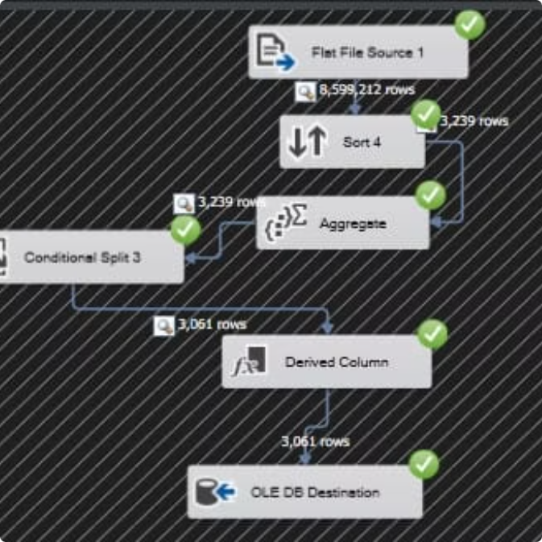
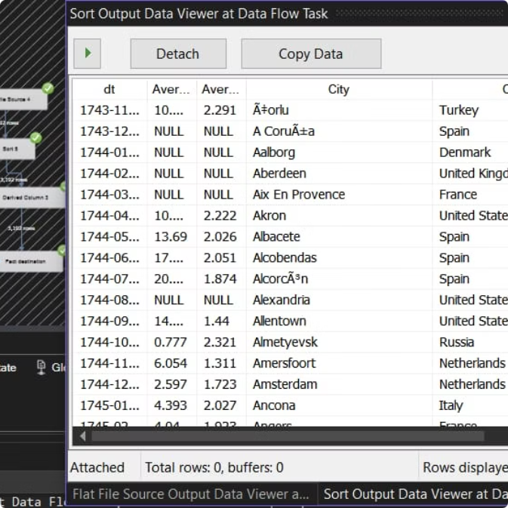
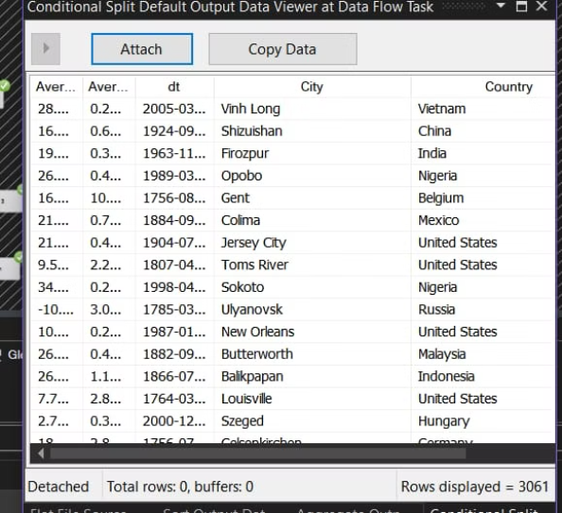
Global Land Temperatures By City table
we handled the NULL values by replacing them with the mean of the respective columns. This ensures that missing data does not negatively impact the analysis and provides a reasonable estimate for absent values.
Additionally, we performed a data type conversion for the latitude and longitude columns using a Derived Column transformation in SSIS. This conversion ensures that these values are in the appropriate format for calculations and further analysis. By applying these transformations, we improved the data quality and consistency in the table.

Slide 8
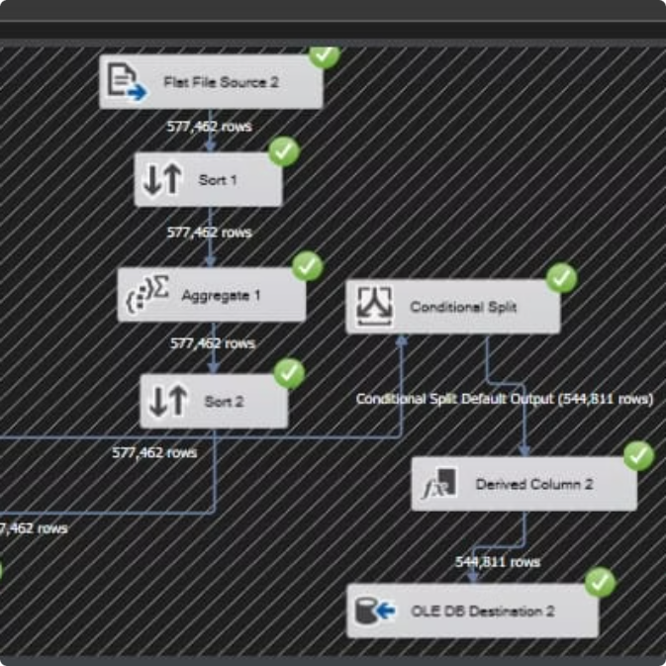
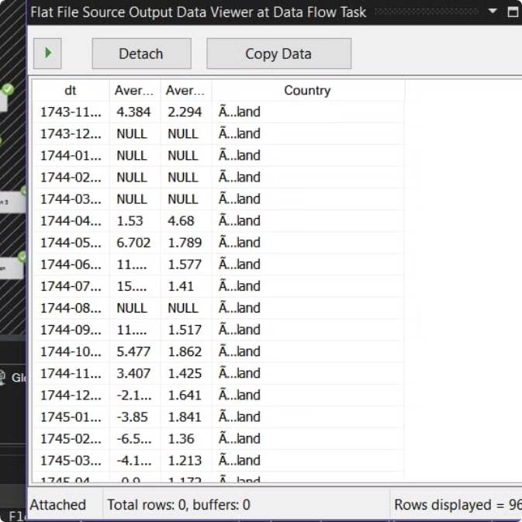
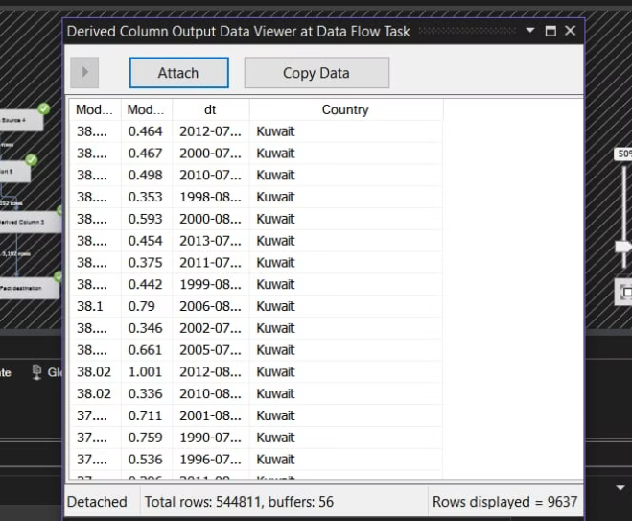
Global Land Temperatures By Country table
both the AverageTemperature and AverageTemperatureUncertainty columns had NULL values. This time, we used the mode to handle them.
We calculated the mode for the entire columns and stored these values in a variable. Then, in the Derived Column transformation, we created an expression that references these variables to handle the NULL values in the specified columns.
This approach ensures that the most frequent value (mode) is used to replace the NULLs, maintaining data consistency while accurately addressing the missing entries.

Slide 9
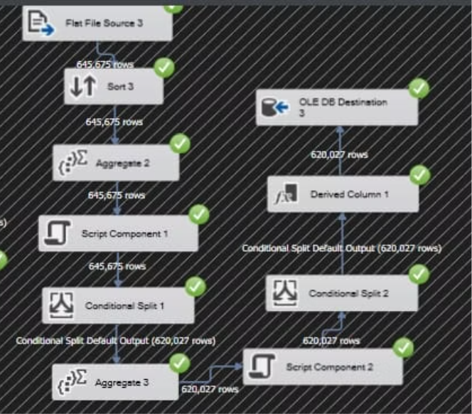
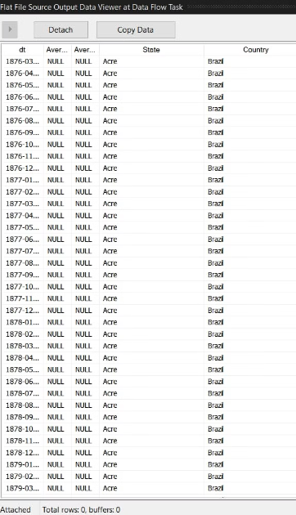
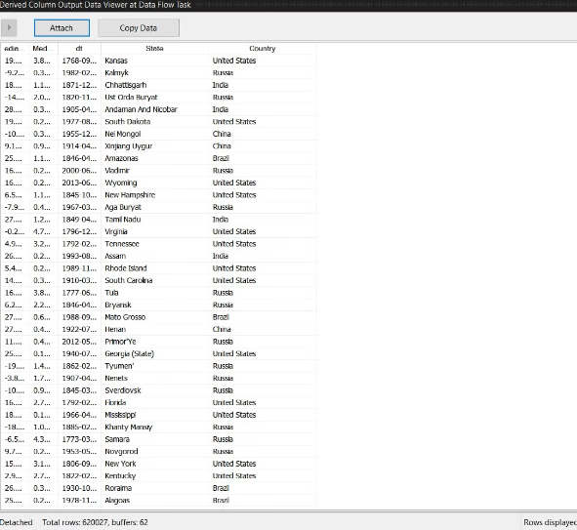
Global Land Temperatures By State table
we handled the NULL values in the AverageTemperature and AverageTemperatureUncertainty columns by replacing them with the median.
Using the median ensures that the replacement value is less influenced by outliers, providing a more robust solution for addressing missing data in these columns. This method helps maintain the accuracy and integrity of the dataset.

Slide 10
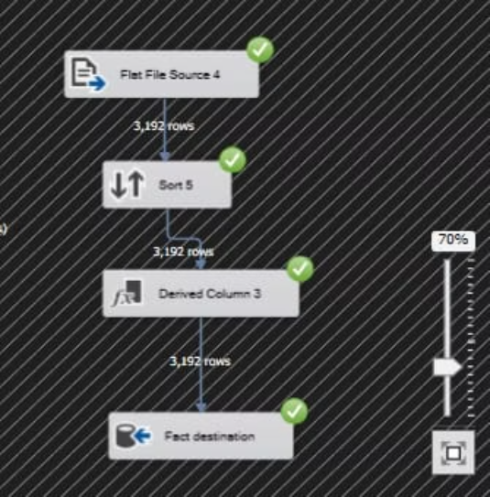
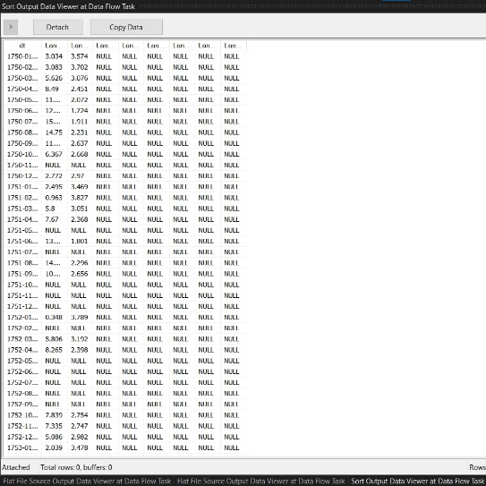
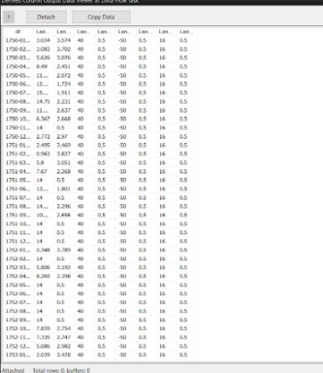
Global Temperatures Fact table (fact table)
we handled the NULL values for the following columns:
LandAverageTemperature
LandAverageTemperatureUncertainty
We replaced the NULL values with default values. This ensures that any missing data is filled with a predefined value, maintaining the integrity of the dataset while avoiding issues caused by missing information. Using default values provides consistency across the dataset, especially when specific values are unavailable.
LandMaxTemperature
LandMaxTemperatureUncertainty
LandMinTemperature
LandMinTemperatureUncertainty
LandAndOceanAverageTemperature

Slide 11
Aggregations Between diemtions and Fact, These aggregations help uncover meaningful trends, correlations, and insights from the global temperature data across different geographical levels and time periods
Regional Averages
Trend Analysis
Comparisons
Calculate average temperatures for different geographical regions.
Identify trends in temperature changes over time using statistical methods.
Compare temperature trends between different regions and time periods.

Slide 12
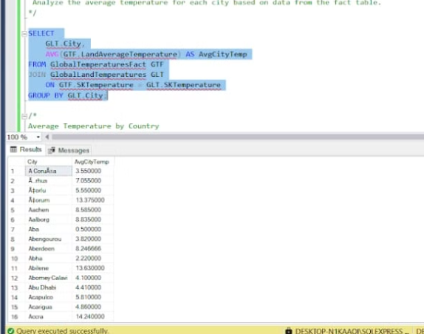
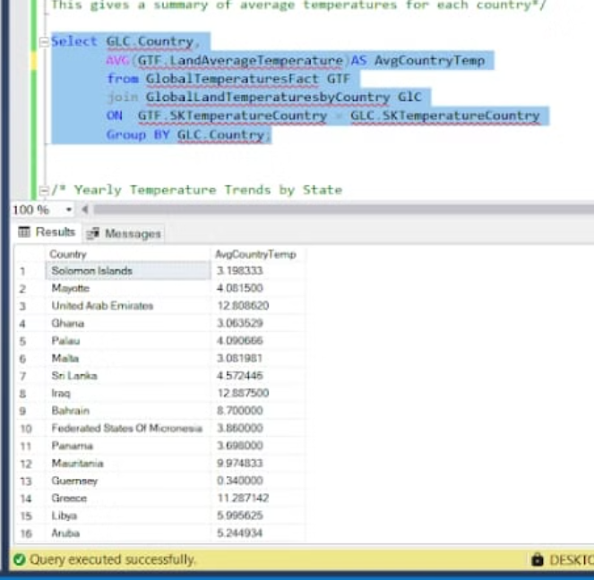
Analysis
To analyze the Global Average Temperature by City, we examine the average temperature for each city using data from the fact table. This involves aggregating temperature values from the fact table and linking them to the city dimension to calculate the overall average for each city.
By performing this analysis, we can:
Compare temperature patterns across different cities globally.
This query generates a summary of the average temperatures for each country by aggregating temperature data from the fact table and using country information from the dimension table. It calculates the mean temperature for each country, providing insights into the typical climate conditions across different regions.
Identify temperature trends specific to each city over time.
Gain valuable insights into how temperatures vary geographically and over time, helping us better understand regional climate changes.

Slide 13
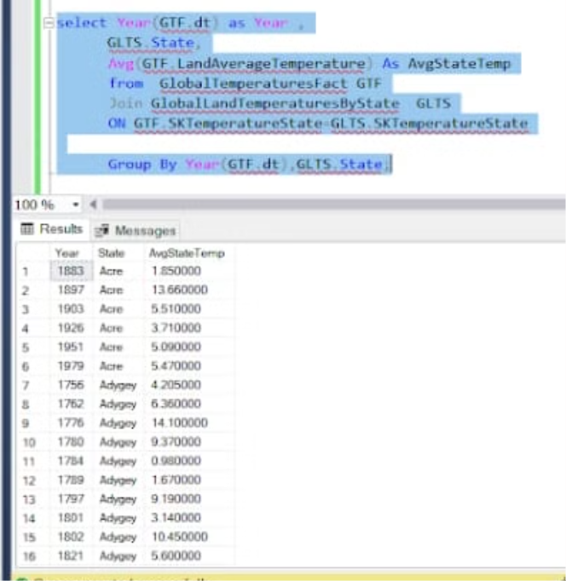
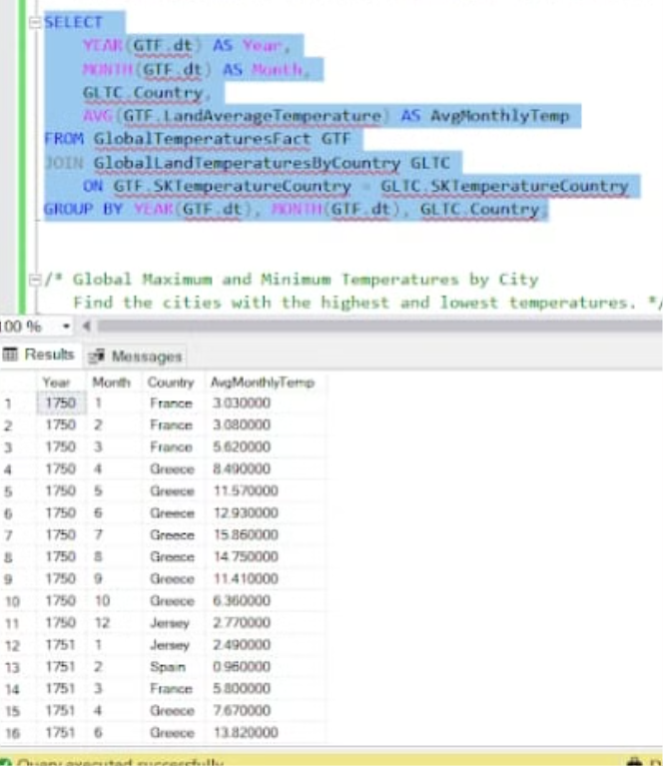
Analysis
This report tracks how temperatures vary from year to year for each state. It highlights the trends and fluctuations in temperature over time, allowing for an understanding of how climate conditions are evolving in different states
This report focuses on tracking and analyzing how temperatures change from month to month in each country. It provides insights into seasonal temperature patterns and fluctuations, giving a detailed view of how climate conditions vary across different months for each country.

Slide 14

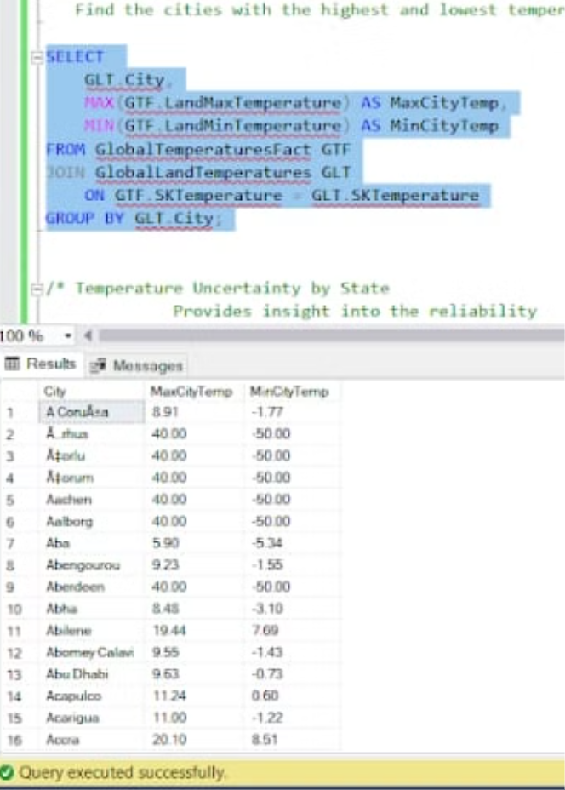
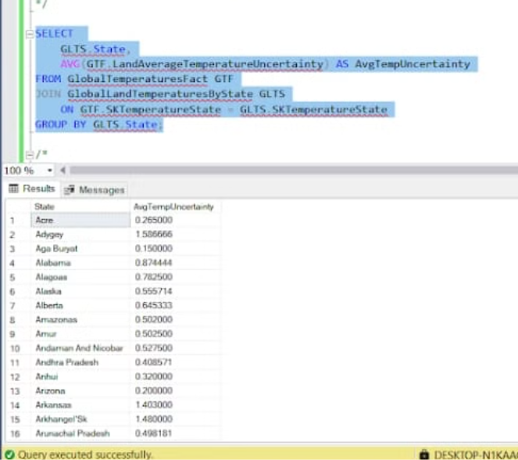
Analysis
This report evaluates how dependable the temperature data is for each state. It focuses on the potential variability or uncertainty in the recorded temperatures, helping to understand how precise or reliable the temperature measurements are for different states.
This report highlights which cities experience the highest and lowest temperatures around the world. It helps to identify temperature extremes by comparing temperature records from various cities, providing insights into the most and least temperature-intensive locations globally.

Slide 15
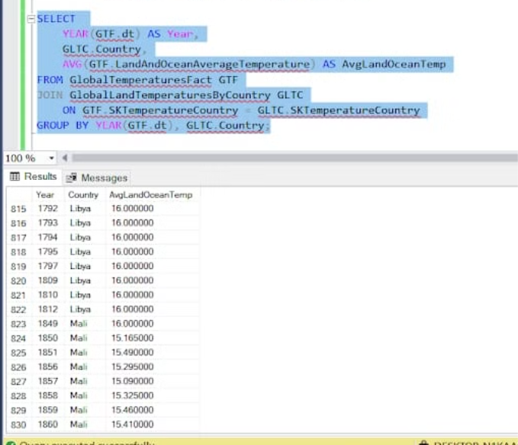
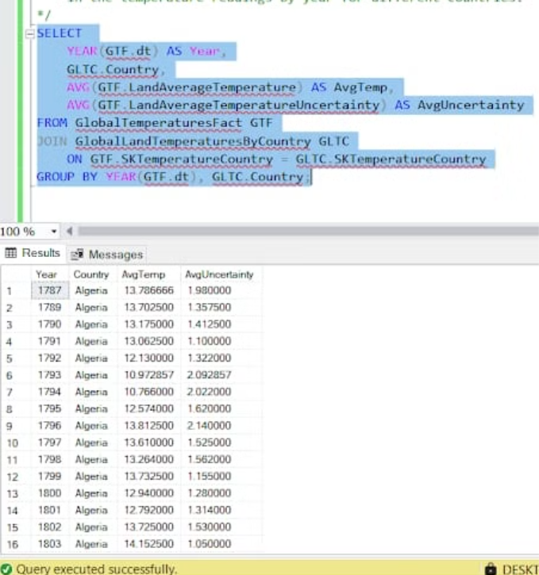
Analysis
This report monitors how the average temperatures of both land and ocean surfaces shift over time for various countries. It combines temperature data from both land and ocean sources to show how overall temperature patterns change annually, giving insights into broader climate trends affecting each country.
This report calculates the average global temperature annually and assesses the degree of uncertainty associated with these temperature measurements. It provides insights into global climate trends while also highlighting the reliability of temperature data from various countries.

Slide 16


Visualizing the Data Using Charts and Graphs
Visualizations play a crucial role in data analysis, enabling us to understand complex information and uncover hidden patterns. They transform raw data into easily digestible and engaging visual representations, making it simpler to identify trends, outliers, and relationships that might otherwise be missed. This is particularly relevant in the context of weather and temperature data, where visualizations help us to see how these factors change over time and across different locations, leading to a deeper understanding of climate patterns and their impact.

Slide 17
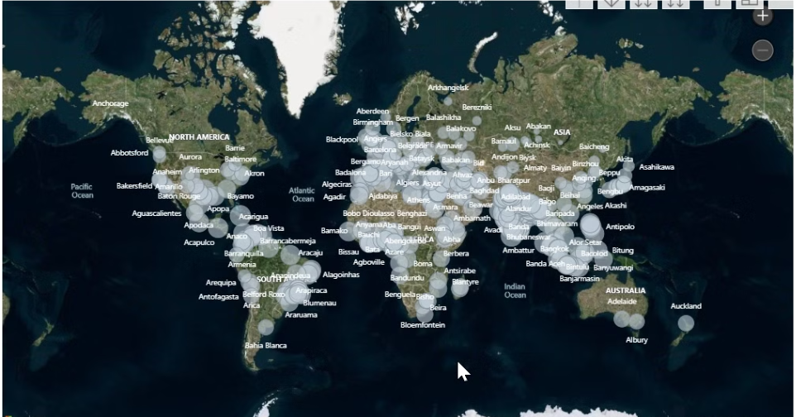
Map Visual
By hovering over each city, we can see the sum of the average temperature and the sum of the average temperature uncertainty
This allows us to quickly visualize and compare the temperature data across different locations
The map provides a high-level, at-a-glance view of the temperature patterns in the region
We can use this to identify any outliers or areas of interest that we may want to explore further in the presentation
Notes:
This slide is a blank canvas with a map visual By hovering over each city, we can see the sum of the average temperature and the sum of the average temperature uncertainty This allows us to quickly visualize and compare the temperature data across different locations The map provides a high-level, at-a-glance view of the temperature patterns in the region We can use this to identify any outliers or areas of interest that we may want to explore further in the presentation

Slide 18
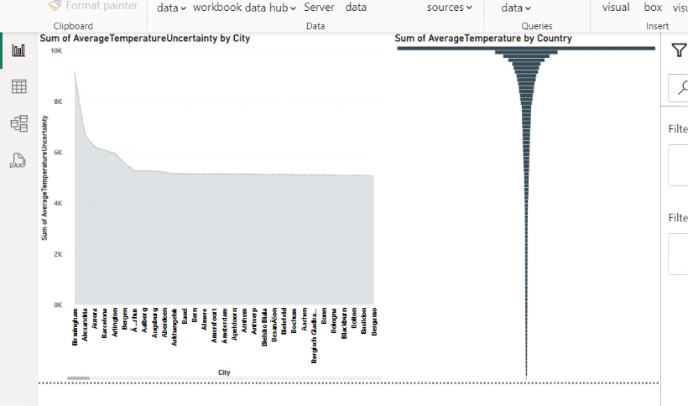
Area chart
The area chart on this slide allows us to visualize the temperature uncertainty for a selected city.
Funnel chart
The funnel chart arranges the countries in descending order by average temperature. Selecting a single country from the funnel chart will update the area chart to reflect the temperature data for that country.
By using these two visualizations together, we can easily compare the temperature patterns across different cities and countries.
This combined view allows us to quickly identify the countries and cities with the most stable or variable temperatures.
Notes:
The area chart on this slide allows us to visualize the temperature uncertainty for a selected city. The funnel chart arranges the countries in descending order by average temperature. Selecting a single country from the funnel chart will update the area chart to reflect the temperature data for that country. By using these two visualizations together, we can easily compare the temperature patterns across different cities and countries. The area chart gives us a detailed view of the temperature uncertainty, while the funnel chart provides a high-level summary of the average temperatures. This combined view allows us to quickly identify the countries and cities with the most stable or variable temperatures.

Slide 19
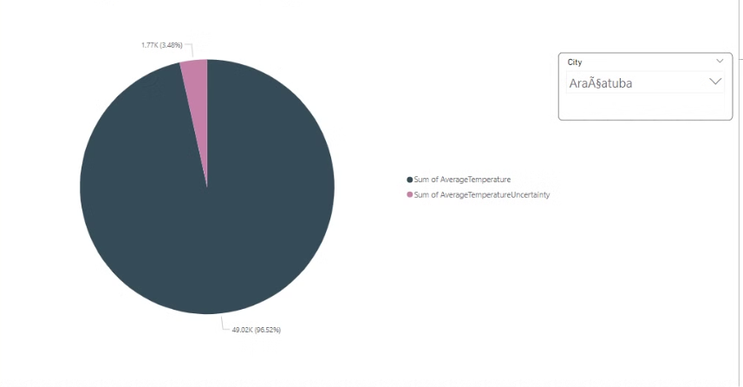
Pie chart
The pie chart provides a visual representation of the temperature data, making it easy to compare the average temperature and uncertainty for different cities.
The pie chart on this slide shows the average temperature and average temperature uncertainty for a selected city.
Users can use the sort dropdown list to select a specific city, and the pie chart will update to reflect the data for that city.
Notes:
The pie chart on this slide shows the average temperature and average temperature uncertainty for a selected city. Users can use the sort dropdown list to select a specific city, and the pie chart will update to reflect the data for that city. The pie chart provides a visual representation of the temperature data, making it easy to compare the average temperature and uncertainty for different cities. I'll walk through the key insights we can gather from the pie chart once the audience has had a chance to review the data for the selected city.

Slide 20





Conclusions and Key Insights
Temperature Trends
Seasonal Variations
Climate Change Impact
Data-Driven Insights
Identify significant warming trends in certain regions.
Explore the influence of seasons on weather patterns.
Investigate the potential relationship between weather and climate change.
Extract valuable insights from the data to inform decision-making.

Slide 21
THANK YOU ☺
Made by:
Reema Hariry
Nadia Talaat
Jessica Boles
Mohamed El Sharkawy
Amr Khaled

